Slide 1
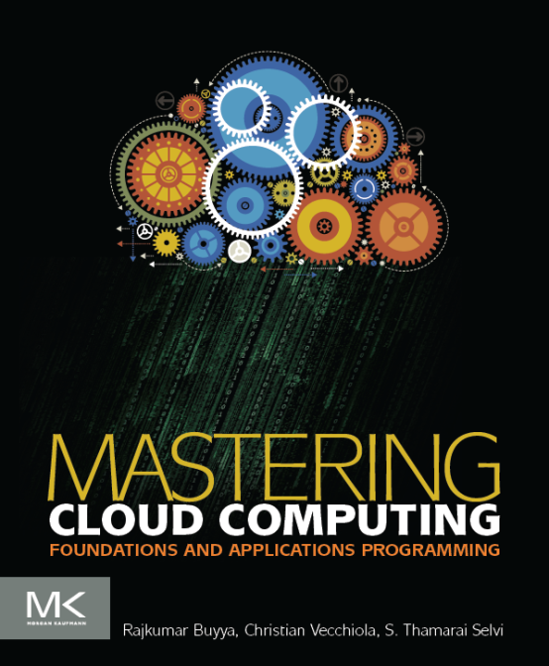
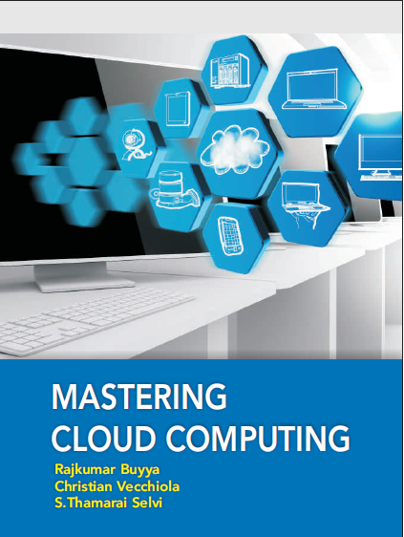
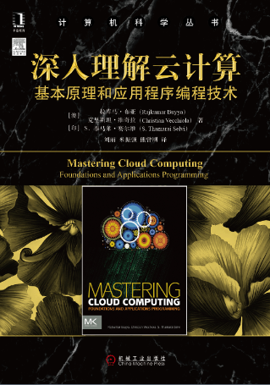
Cloud Application Development
Morgan Kauffman, USA
McGraw Hill, India
China Machine Press, China

Slide 2
Unit 5 : Use Cases of Cloud Applications
Scientific Applications
Health care Analysis in the Cloud
Biology
Geo Science
Business and Consumer Applications
Productivity
Social Networking
Media Applications
Multiplayer online gaming

Slide 3
Unit 5 : Objectives
After completing this unit you should be able to
Cloud Applications
Scientific Applications
Healthcare : ECG Analysis in the Cloud
Biology : Protein Structure Prediction
GeoScience : Satellite Image Processing
Business and Consumer Applications
Productivity
Cloud Desktops : EyeOS and XIOS/3
Social Networking
Media Applications
Multiplayer Online Gaming
Summary

Slide 4
Unit 5 : Objectives
After completing this unit you should be able to
Cloud Applications
Scientific Applications
Healthcare : ECG Analysis in the Cloud
Biology : Protein Structure Prediction
GeoScience : Satellite Image Processing
Business and Consumer Applications
Productivity
Cloud Desktops : EyeOS and XIOS/3
Social Networking
Media Applications
Multiplayer Online Gaming
Summary

Slide 5
Cloud Applications
Cloud computing has gained huge popularity in industry due to its ability to host applications whose services can be delivered to consumers rapidly at minimal cost.
This chapter discusses various application case studies detailing their architecture and how they leveraged various Cloud technologies.
Applications from a range of domains from scientific to engineering, gaming, to social networking are considered.

Slide 6
Unit 5 : Objectives
After completing this unit you should be able to
Cloud Applications
Scientific Applications
Healthcare : ECG Analysis in the Cloud
Biology : Protein Structure Prediction
GeoScience : Satellite Image Processing
Business and Consumer Applications
Productivity
Cloud Desktops : EyeOS and XIOS/3
Social Networking
Media Applications
Multiplayer Online Gaming
Summary

Slide 7
Scientific Applications
Scientific applications are a sector that is increasingly using Cloud computing systems and technologies.
The immediate benefit seen by researchers and academics is the potentially infinite availability of computing resources and storage at sustainable prices if compared to a complete in-house deployment.
Cloud computing systems meet the needs of different types of applications in the scientific domain: HPC (High Performance Computing) applications, HTC (High Throughput Computing) applications, and data-intensive applications.
The opportunity for using Cloud resources is even more appealing since minimal changes need to be done to existing applications in order to leverage Cloud resources.

Slide 8
Unit 5 : Objectives
After completing this unit you should be able to
Cloud Applications
Scientific Applications
Healthcare : ECG Analysis in the Cloud
Biology : Protein Structure Prediction
GeoScience : Satellite Image Processing
Business and Consumer Applications
Productivity
Cloud Desktops : EyeOS and XIOS/3
Social Networking
Media Applications
Multiplayer Online Gaming
Summary

Slide 9
Healthcare : ECG Analysis in the Cloud
Healthcare is a domain where computer technology has found several and diverse applications: from supporting the business functions to assisting scientists in developing solutions to cure diseases.
An important application is the use of Cloud technologies for supporting doctors in providing more effective diagnostic processes.
In particular, we discuss electrocardiogram (ECG) data analysis on the Cloud.

Slide 10
Healthcare : ECG Analysis in the Cloud
The capillary development of Internet connectivity and its accessibility from any device at any time has made Cloud technologies an attractive option for developing health-monitoring systems.
Electrocardiogram (ECG) data analysis and monitoring constitutes a case study that naturally fits in this scenario. ECG is the electrical manifestation of the contractile activity of the heart’s myocardium.
This activity produces a specific waveform that is repeated overtime and that represents the heartbeat.
The analysis of the shape of the waveform is used to identify arrhythmias and it is the most common way for detecting heart diseases.
Cloud computing technologies allow the remote monitoring of a patient’s heartbeat data, its analysis in minimum time, and the notification of first-aid personnel and doctors should this data reveal potentially dangerous conditions.
This way a patient at risk can be constantly monitored without going to hospital for ECG analysis. At the same time, doctors and first-aid personnel can instantly be notified with cases that require their attention.

Slide 11















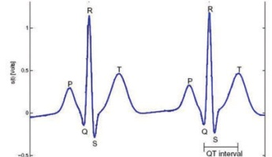
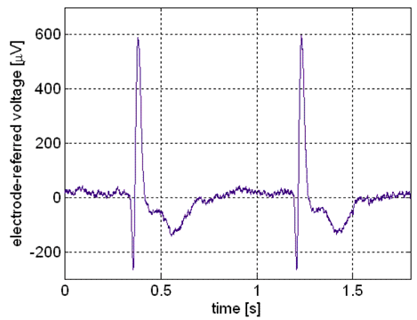
Healthcare : ECG Analysis in the Cloud
User
Large Number
ECG Sensor
Embedded Bluetooth Enabled
Data Communication & Processor Module
1
(detailed view)
User Requests
User Requests
ECG Sensor Module
User Requests
ECG Data Analysis as a Service
SaaS
2
Bluetooth connectivity
Dynamically Scalable Runtime
(QoS-based scaling of computing resources)
Security Runtime
4
PaaS
3
Wireless / Mobile 3G Network
IaaS
6
5

Slide 12
Healthcare : ECG Analysis in the Cloud
Even though remote ECG monitoring does not necessarily require Cloud technologies, Cloud computing introduces opportunities that would be otherwise hardly achievable.
The first advantage is the elasticity of the Cloud infrastructure that can grow and shrink according to the requests served. As a result, doctors and hospitals do not have to invest in large computing infrastructures designed after capacity planning, thus making a more effective use of budgets. The second advantage is ubiquity.
Cloud computing technologies have now become easily accessible and promise to deliver systems with minimum or no downtime. Computing systems hosted in the Cloud are accessible from any Internet device through simple interfaces (such as SOAP and REST based web services).
This makes not only these systems ubiquitous but they can also be easily integrated with other systems maintained in the hospital’s premises. Lastly, cost savings constitute another reason.
Cloud services are priced on a pay-per-use basis and with volume prices in case of large numbers of service requests. These two models provide a set of flexible options that can be used to price the service, thus actually charging costs based on effective use rather than capital costs.

Slide 13
Unit 5 : Objectives
After completing this unit you should be able to
Cloud Applications
Scientific Applications
Healthcare : ECG Analysis in the Cloud
Biology : Protein Structure Prediction
GeoScience : Satellite Image Processing
Business and Consumer Applications
Productivity
Cloud Desktops : EyeOS and XIOS/3
Social Networking
Media Applications
Multiplayer Online Gaming
Summary

Slide 14
Biology : Protein Structure Prediction
Applications in biology often require high computing capabilities and often operate on large datasets that cause extensive I/O operations.
Because of these requirements, they have often made extensive use of supercomputing and cluster computing infrastructures. Similar capabilities can be leveraged on-demand by using Cloud computing technologies in a more dynamic fashion thus opening new opportunities for bioinformatics applications.
Protein structure prediction is a computationally intensive task fundamental for different types of research in the life sciences.
Among these is the design of new drugs for the treatment of diseases. The geometrical structure of a protein cannot be directly inferred from the sequence of genes that compose its structure, but it is the result of complex computations aimed at identifying the structure that minimizes the required energy.
This task requires the investigation of a space with a massive number of states, and consequently creating a large number of computations for each of these states.
The computational power required for protein structure prediction can now be acquired on demand, without owning a cluster or doing all the bureaucracy for getting access to parallel and distributed computing facilities. Cloud computing grants the access to such capacity on a pay-per-use basis.

Slide 15


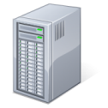



Biology : Protein Structure Prediction
Jeeva Portal
Aneka
Task Graph
A
A : BLAST
B : Create Data Vector
C : HH Classifier
D : SS Classifier
E : TT Classifier
F : HS Classifier
G : ST Classifier
H : TH Classifier
I : Predict Final Secondary
Structure
Initial Phase
B
Classification
Phase
C
D
E
F
G
H
Final Phase
I

Slide 16
Biology: Gene Expression Data Analysis for Cancer Diagnosis
Gene expression profiling is the measurement of the expression levels of thousands of genes at once. It is used to understand the biological processes that are triggered by the treatment at a cellular level.
Together with protein structure prediction, this activity is a fundamental component of drug design since it allows scientists to identify the effects of a specific treatment.
Another important application of gene expression profiling is cancer diagnosis and treatment. Cancer is a disease characterized by uncontrolled cell growth and proliferation.
This behavior occurs because of genes regulating the cell growth mutate. This means that all the cancerous cells contain mutated genes.
In this context, gene expression profiling is utilized to provide a more accurate classification of tumors.
The classification of gene expression data samples into distinct classes is a challenging task.
The dimensionality of typical gene expression data sets ranges from several thousands to over ten thousands genes. However, only small sample sizes are typically available for analysis.

Slide 17
Cloud-CoXCS: An Environment for MicroArray Data Processing On the Cloud
Datasets
Cloud-CoXCS
(Task orchestrator)
CoXCS Tasks
Aneka
Elastic Sizing (EC2,…, )

Slide 18
Cloud-CoXCS: An Environment for MicroArray Data Processing On the Cloud
This problem is often approached with learning classifiers, which generate a population of condition-action rule that guide the classification process.
Among these, the eXtended Classifier System (XCS) has been successfully utilized for classifying large datasets in the bioinformatics and computer science domains. However, the effectiveness of XCS when confronted with high dimensional data sets (such as microarray gene expression data sets) has not been explored in detail.
A variation of such algorithm, CoXCS, has proven to be effective in these conditions. CoXCS divides the entire search space into subdomains an employs the standard XCS algorithm in each of these subdomains.
Such a process is computationally intensive but can be easily parallelized as the classifications problems on the subdomains can be solved concurrently. Cloud-CoXCS is a Cloud-based implementation of CoXCS that leverages Aneka to solve the classification problem in parallel and compose their outcomes.
The algorithm is controlled by strategies, which define the way in which the outcomes are composed together and whether the process needs to be iterated.
Because of the dynamic nature of XCS, the number of required compute resources to execute it can vary over time. Therefore, the use of a scalable middleware such as Aneka offers a distinctive advantage.

Slide 19
Unit 5 : Objectives
After completing this unit you should be able to
Cloud Applications
Scientific Applications
Healthcare : ECG Analysis in the Cloud
Biology : Protein Structure Prediction
GeoScience : Satellite Image Processing
Business and Consumer Applications
Productivity
Cloud Desktops : EyeOS and XIOS/3
Social Networking
Media Applications
Multiplayer Online Gaming
Summary

Slide 20
GeoScience : Satellite Image Processing
Geoscience applications collect, produce, and analyse massive amounts of geospatial and non-spatial data.
As the technology progresses and our planet becomes more instrumented (i.e., through the deployment of sensors and satellites for monitoring), the volume of data that need to be processed increases significantly. In particular, the geographic information system (GIS) is a major element of geoscience applications. GIS applications capture, store, manipulate, analyze, manage, and present all types of geographically referenced data.
This type of information is now becoming increasingly relevant to a wide variety of application domains: from advanced farming to civil security and also natural resources management.
As a result, a considerable amount of geo-referenced data is ingested into computer systems for further processing and analysis. Cloud computing is an attractive option for executing these demanding tasks and extracting meaningful information for supporting decision makers.

Slide 21
GeoScience : Satellite Image Processing
Satellite remote sensing generates hundreds of gigabytes of raw images that need to be further processed to become the basis of several different GIS products. This process requires both I/O and compute intensive tasks.
Large size images need to be moved from the ground station’s local storage to compute facilities where several transformations and corrections are applied. Cloud computing provides the appropriate infrastructure to support such application scenario. A Cloud-based implementation of such a workflow has been developed by the Department of Space, Government of India.
The system shown in Figure integrates several technologies across the entire computing stack.
A SaaS application provides a collection of services for such as geocode generation and data visualization.
At the PaaS level Aneka controls the import of data into the virtualized infrastructure and the execution of image processing tasks that produce the desired outcome from raw satellite images.
The platform leverages a Xen private Cloud and the Aneka technology to dynamically provision the required resources (i.e, grow or shrink) on demand.

Slide 22


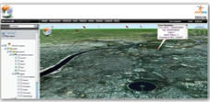




GeoScience : Satellite Image Processing
Portal (SaaS)
Archiving
Distribution
Local Storage
Aneka
Public Cloud
Private Cloud

Slide 23
Unit 5 : Objectives
After completing this unit you should be able to
Cloud Applications
Scientific Applications
Healthcare : ECG Analysis in the Cloud
Biology : Protein Structure Prediction
GeoScience : Satellite Image Processing
Business and Consumer Applications
Productivity
Cloud Desktops : EyeOS and XIOS/3
Social Networking
Media Applications
Multiplayer Online Gaming
Summary

Slide 24
Business and Consumer Applications
The business and consumer sector is the one that probably benefits the most from Cloud computing technologies.
On the one hand the opportunity of transforming capital cost into operational costs makes Clouds an attractive option for all enterprises that are IT centric.
On the other hand, the sense of ubiquity that Cloud offers for accessing data and services makes it interesting for end users as well.
Moreover, the elastic nature of Cloud technologies does not require huge upfront investments, thus allowing new ideas to be quickly translated into products and services that can comfortably grow with the demand.
The combination of all these elements has made Cloud computing the preferred technology for a wide range of applications: from CRM and ERP systems to productivity and social networking applications

Slide 25
CRM and ERP
Customer Relationship Management (CRM) and Enterprise Resource Planning (ERP) applications are market segments that are flourishing in the Cloud, with CRM applications being more mature than ERP implementations.
Cloud CRM applications constitute a great opportunity for small enterprises and start-ups to have a fully functional CRM software without large upfront costs and by paying subscriptions.
Moreover, customer relationship management is not an activity that requires specific needs and it can be easily moved to the Cloud. Such a characteristic, together with the possibility of having access to your business and customer data from everywhere and any device, has fostered the spread of Cloud CRM applications. ERP solutions on the Cloud are less mature and have to compete with well-established in-house solutions.
ERP systems integrate several aspects of an enterprise: finance and accounting, human resources, manufacturing, supply chain management, project management, and customer relationship management.

Slide 26
SalesForce.com
Salesforce.com is probably the most popular and developed CRM solutions available today. As of today more than 100 thousands customers have chosen Safesforce.com to implement their CRM solutions.
The application provides customizable CRM solutions that can be integrated with additional features developed by third parties. Salesforce.com is based on the Force.com Cloud development platform.
This represents the scalable and high-performance middleware executing all the operations of all Salesforce.com applications.

Slide 27
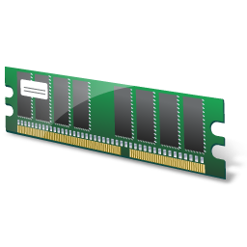



SalesForce.com
Force.com Platform
User-base 1: Application 1
Metadata Cache
Bulk Processing Engine
Pivot Tables
Metadata Tables (UDD)
Multitenant-aware Query Optimiser
Runtime Application Generator
Data Tables
Full-text Search Engine
Shared Database
User-base 2: Application 2
COMMON APPLICATION SCREENS
TENANT-SPECIFIC
SCREENS
OBJECTS (TABLES)
Indexes
Virtual Application Components
User-base 3: Application 3

Slide 28
Microsoft Dynamics CRM
Microsoft Dynamics CRM is the solution implemented by Microsoft for customer relationship management. Dynamics CRM is available either for installation on the enterprise’s premises or as an online solution priced with a monthly per user subscription.
The system is completely hosted in Microsoft’s data center across the world and offers to customers a 99.9% SLA, with bonus credits in case the system does not fulfill the agreement.
Each CRM instance is deployed on a separate database, and the application provides users with facilities for marketing, sales, and advanced customer relationship management.
Dynamics CRM Online features can be accessed either through a web browser interface or programmatically by means of SOAP and RESTful web services.
This allows Dynamics CRM to be easily integrated with both other Microsoft products and line of business applications.
Dynamics CRM can be extended by developing plug-ins that allow implementing specific behaviors triggered on the occurrence of given events. Dynamics CRM can also leverage the capability of Windows Azure for the development and integration of new features.

Slide 29
NetSuite
NetSuite provides a collection of applications that help customers manage every aspect of the business enterprise. Its offering is divided in three major products: NetSuite Global ERP, NetSuite Global CRM+, and NetSuite Global Ecommerce. Moreover, an all-in-one solution integrates all the three products together: NetSuite One World.
The services delivered by the company are powered by two large datacenters on the opposite coasts (east and west coasts) of the United States connected by redundant links. This allows NetSuite to guarantee 99.5% of uptime to its customers.
Besides the pre-packaged solutions, NetSuite also provides and infrastructure and a development environment for implementing customized applications. The NetSuite Business Operating System (NS-BOS) is a complete stack of technologies for building Software-as-a-Service business applications that leverage the capabilities of NetSuite products.
On top of the SaaS infrastructure, the NetSuite Business Suite components offer accounting, ERP, CRM, and e-commerce capabilities. An online development environment, SuiteFlex, allows integrating such capabilities into new web applications, which are then packaged for distribution by SuiteBundler.
The entire infrastructure is hosted in the NetSuite datacenters, which provide the warranties about the application uptime and availability.

Slide 30
Unit 5 : Objectives
After completing this unit you should be able to
Cloud Applications
Scientific Applications
Healthcare : ECG Analysis in the Cloud
Biology : Protein Structure Prediction
GeoScience : Satellite Image Processing
Business and Consumer Applications
Productivity
Cloud Desktops : EyeOS and XIOS/3
Social Networking
Media Applications
Multiplayer Online Gaming
Summary

Slide 31
Productivity
Productivity applications replicate in the Cloud some of the most common tasks that we are used to perform on our desktop: from document storage, to office automation, and complete desktop environment hosted in the Cloud.
DropBox and iCloud
Google Docs
Cloud Desktops/ EyeOS and XIOS/3

Slide 32
DropBox and iCloud
One of the core features of Cloud computing is to be available anywhere, at anytime, and from any Internet connected device.
Therefore, document storage constitutes a natural application for such technology. Online storage solutions are precedent to Cloud computing, but they have never become popular.
With the development of Cloud technologies they have turn into Software-as-a-Service applications and become more usable as well as more advanced and accessible.
Perhaps the most popular solution for online document storage is Dropbox. This is an online application that allows you to synchronise any file across any platform and any device in a seamless manner.
Dropbox provides users with a free amount of storage that is accessible through the abstraction of a folder.
Users can either access their Dropbox folder through a browser or by downloading and installing a Dropbox client, which provides access to the online storage by means of a special folder. All the modifications into this folder are silently synched so that changes are notified to all the local instances of the Dropbox folder across all the devices.
The key advantage of Dropbox is its availability on different platforms (Windows, Mac, Linux, and mobile) and the capability to work seamlessly and transparently across all of them.

Slide 33
DropBox and iCloud
Another interesting application in this area is iCloud. iCloud is a Cloud-based document sharing application provided by Apple to synchronise IOS-based devices in a completely transparent manner.
Differently from Dropbox, which provides synchronization through the abstraction of a local folder, iCloud has been designed to be completely transparent once it has been set up: documents, photos, and videos are automatically synched as changes are made without any explicit operation.
This allows to efficiently automate common operations without any human intervention: taking a picture with an iPhone and having it automatically available in iPhoto on your Mac at home; editing a document in the iMac at home and having the changes updated in the iPad.
Unfortunately, this capability is limited only to IOS devices and currently there are no plans to provide iCloud with a web-based interface that would make user’s content accessible even from unsupported platforms.

Slide 34






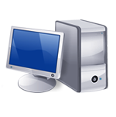







DropBox Usage Scenario
Dropbox Folder
Automatic
synchronization
Dropbox Folder
Dropbox Folder

Slide 35
Google Docs
Google Docs is a Software-as-a-Service (SaaS) application that delivers the basic office automation capabilities with support for collaborative editing over the Web. The application is executed on top of Google distributed computing infrastructure that allows the system to dynamically scale according to the number the users using the service.
Google Docs allows creating and editing text documents, spreadsheets, presentations, forms, and drawings.
It aims to substitute desktop products such as Microsoft Office and OpenOffice and provide similar interface and functionality as a Cloud service. It supports collaborative editing over the web for most of the applications included in the suite.
This eliminates tedious mailing and synchronization tasks when documents need to be edited by multiple users. By being stored in the Google infrastructure these documents are always available from anywhere and any device that is connected to the Internet. Moreover, the suite allows users to work off-line in case the Internet connectivity is not available.
The support of various formats such as those that are produced by the most popular desktop office solutions allows user to easily import and move documents in and out of Google Docs, thus eliminating barriers for the use of this application.
Google Docs is a good example of what Cloud computing can deliver to end users: ubiquitous access to resources, elasticity, absence of installation and maintenance costs, and delivery of core functionalities as a service.

Slide 36
Unit 5 : Objectives
After completing this unit you should be able to
Cloud Applications
Scientific Applications
Healthcare : ECG Analysis in the Cloud
Biology : Protein Structure Prediction
GeoScience : Satellite Image Processing
Business and Consumer Applications
Productivity
Cloud Desktops : EyeOS and XIOS/3
Social Networking
Media Applications
Multiplayer Online Gaming
Summary

Slide 37
Cloud Desktops : EyeOS and XIOS/3
Asynchronous Javascript and XML (AJAX) technologies have considerably augmented the capabilities that can be implemented in web applications.
This is a fundamental aspect for Cloud computing that delivers a considerable amount of its services through the web browser.
Together with the opportunity of leveraging large-scale storage and computation, this technology has made possible the replication of complex desktop environments in the Cloud and made them available through the web browser. These applications are called Cloud desktops and rapidly gaining popularity.

Slide 38




EyeOS Architecture
User
EyeOS Server
User
eyeos
apps
User
extern
extras
system
users
Client-side scripts
workgroups

Slide 39
XIOS/3
Xcerion XML Internet OS/3 (XIOS/3) is another example of a web desktop environment.
The service is delivered as part of the CloudMe application, which is a solution for Cloud document storage.
The key differentiator of XIOS/3 is its strong leverage on XML, used to implement many of the tasks of the OS: rendering user interfaces; defining application business logics; structuring file system organization; and even application development.
The architecture of the OS concentrates most of the functionalities on the client side, while implementing server based functionalities by means of XML web services.
The client side renders the user interface, orchestrates processes, and provides data binding capabilities on XML data that is exchanged with web services.
The server is responsible for implementing core functions such as transaction management for documents edited in a collaborative mode, and core logic of installed application into the environment.
XIOS/3 also provides an environment for developing application (XIDE), which allows users to quickly develop complex applications by visual tools for the user interface and XML documents for business logic.

Slide 40
XIOS/3
XIOS/3 is released as open source software and implements a market place where third parties can easily deploy applications that can be installed on top of the virtual desktop environment.
It is possible to develop any type of application and feed it with data accessible through XML web services: developers have to define the user interface, bind UI components to service calls and operations, and provide the logic on how to process the data.
XIDE will package this information into a proper set of XML documents and the rest will be performed by XML virtual machine implemented in XIOS.
XIOS/3 is an advanced web desktop environment that focuses on the integration of services into the environment by means of XML-based services and simplifies collaboration with peers.

Slide 41
Unit 5 : Objectives
After completing this unit you should be able to
Cloud Applications
Scientific Applications
Healthcare : ECG Analysis in the Cloud
Biology : Protein Structure Prediction
GeoScience : Satellite Image Processing
Business and Consumer Applications
Productivity
Cloud Desktops : EyeOS and XIOS/3
Social Networking
Media Applications
Multiplayer Online Gaming
Summary

Slide 42
Social Networking
Social networking applications have considerably grown in the last years to become the most active sites on the web. In order to sustain their traffic and to serve millions of users seamlessly,
services like Twitter or Facebook, have leveraged Cloud computing technologies.
The possibility of continuously adding capacity while systems are running is the most attractive feature for social networks, which constantly increase their user base.

Slide 43
Facebook
Facebook is probably the most evident and interesting environment in social networking. It became one of the largest web sites in the world with more than 800 million users. In order to sustain this incredible growth it has been fundamental to be capable of continuously adding capacity, developing new scalable technologies and software systems while keeping a high performance for a smooth user experience.
Currently, the social network is backed by two data centers that have been built and optimized to reduce costs and impact on the environment. On top of this highly efficient infrastructure built and designed out of inexpensive hardware, a completely customized stack of open source technologies opportunely modified and refined constitutes the backend of largest social network.
Taken all together, these technologies constitute a powerful platform for developing Cloud applications.
This platform primarily supports Facebook itself and offers APIs to integrate third party applications with Facebook’s core infrastructure to deliver additional services such as social games and quizzes created by others.

Slide 44
Facebook
The reference stack serving Facebook is based on LAMP (Linux, Apache, MySQL, and PHP). This collection of technologies is accompanied by a collection of other services developed in-house.
These services are developed in a variety of languages and implement specific functionalities such as search, new feeds, notifications, and others.
While serving page requests, the social graph of the user is composed. The social graph identifies collection of interlinked information that is of relevance for a given user.
Most of the user data is served by querying a distributed cluster of MySQL instances, which mostly contain key-value pairs. This data is then cached for faster retrieval.
The rest of the relevant information is then composed together by using the services mentioned before.
These services are located closer to the data and developed in languages that provide a better performance than PHP.

Slide 45
Facebook
The development of services is facilitated by a set of tools internally developed. One of the core elements is Thrift.
This is a collection of abstractions (and language bindings) that allow cross-language development.
Thrift allows services developed in different languages to communicate and exchange data. Bindings for Thrift in different languages take care of data serialization and deserialization, communication, and client and server boilerplate code.
This simplifies the work of the developers that can quickly prototype services and leverage existing one. Other relevant services and tools are Scribe, which aggregates streaming log feeds, and applications for alerting and monitoring.

Slide 46
Unit 5 : Objectives
After completing this unit you should be able to
Cloud Applications
Scientific Applications
Healthcare : ECG Analysis in the Cloud
Biology : Protein Structure Prediction
GeoScience : Satellite Image Processing
Business and Consumer Applications
Productivity
Cloud Desktops : EyeOS and XIOS/3
Social Networking
Media Applications
Multiplayer Online Gaming
Summary

Slide 47
Media Applications
Media applications are a niche that has taken a considerable advantage from leveraging Cloud computing technologies.
In particular, video processing operations, such as encoding, transcoding, composition, and rendering, are good candidates for a Cloud-based environment.
These are computationally intensive tasks that can be easily offloaded to Cloud computing infrastructures.

Slide 48
Animoto
Animoto is perhaps the most popular example of media applications on the Cloud. The website provides users with a very straightforward interface for quickly creating videos out of images, music, and video fragments submitted by users.
Users select a specific theme for the video, upload the photos and videos and order them in the sequence they want to appear, select the song for the music, and render the video.
The process is executed in the background and the user is notified via e-mail once the video is rendered.
The core value of Animoto is the ability to quickly create videos with stunning effects without the user intervention.
A proprietary AI engine that selects the animation and transition effects according to pictures and music drives the rendering operation.
Users only have to define the storyboard by organizing pictures and videos into the desired sequence. If not, the video can be rendered again and the engine will select a different composition, thus producing a different outcome every time. The service allows creating 30 seconds videos for free.
By paying a monthly or a yearly subscription it is possible to produce videos of any length and to choose among a wider range of templates.

Slide 49

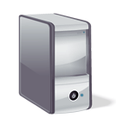




Animoto Reference Architecture
EC2 instances:
web front end
Scalability engine
Amazon SQS
Amazon S3:
Video storage
EC2 instances: video rendering

Slide 50
Maya Rendering with Aneka
Interesting applications of media processing are found in the engineering disciplines and the movie production industry. Operations such as rendering of models are now an integral part of the design workflow, which has become computationally demanding.
The visualization of mechanical models is not only used at the end of the design process, but it is iteratively used to improve the design.
It is then fundamental to perform such task as fast as possible. Cloud computing provides engineers with the necessary computing power to make this happen.

Slide 51
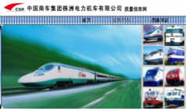
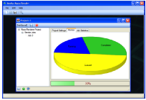
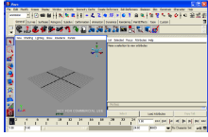
3D Rendering On Private Clouds
Aneka Maya Render
Render Tasks
Aneka
Render Files
Networked LAN
Scenarios
Maya: Train Design

Slide 52
Video Encoding on the Cloud : Encoding.com
Video encoding and transcoding are operations that can take a great benefit from using Cloud technologies: they are computationally intensive and potentially require considerable amount of storage.
Moreover, with the continuous improvement of mobile devices as well as the diffusion of Internet, requests for video content have significantly increased.
The variety of devices with video playback capabilities has led to an explosion of video formats through which a video can be delivered.
Software and hardware for video encoding and transcoding often have prohibitive costs or are not flexible enough to support conversion from any format to any format.
Cloud technologies present an opportunity for turning these tedious and often demanding tasks into services that can be easily integrated into different workflows or made available to everyone according to their needs.

Slide 53
Video Encoding on the Cloud : Encoding.com
Encoding.com is software solution that offers video transcoding services on demand and leverage Cloud technology to provide both the horse-power required for video conversion and the storage for staging videos.
The service integrates both with Amazon Web Services technologies (EC2, S3, and CloudFront) and Rackspace (Cloud Servers, Cloud Files, and Limelight CDN access).
Users can access the services through a variety of interfaces: Encoding.com website, web service XML APIs, desktop applications, and watched folders.
In order to use the service users have to specify the location of the video to transcode, the destination format, and the target location of the video. Encoding.com also offers other video editing operations such the insertion of thumbnails, watermarks, or logos. Moreover, it also extends its capabilities to audio and image conversion.
The service provides different pricing options: monthly fee, pay-as-you-go (by batches), and special prices for high volumes. Encoding.com has up to now more than 2000 customers and has already processed more than 10 million videos.

Slide 54
Unit 5 : Objectives
After completing this unit you should be able to
Cloud Applications
Scientific Applications
Healthcare : ECG Analysis in the Cloud
Biology : Protein Structure Prediction
GeoScience : Satellite Image Processing
Business and Consumer Applications
Productivity
Cloud Desktops : EyeOS and XIOS/3
Social Networking
Media Applications
Multiplayer Online Gaming
Summary

Slide 55
Multiplayer Online Gaming
Online multiplayer gaming attracts millions of gamers around the world that share a common experience by playing together on a virtual environment that extends beyond the boundaries of a normal LAN.
Online games support hundreds of players in the same session and this is made possible by the specific architecture used to forward interactions that is based on game log processing.
Players update the game server hosting the game session and the server integrates all the updates into a log that is made available to all the players through a TCP port.
The client software used for the game connects to the log port and by reading the log updates the local user interface with the actions of other players.

Slide 56
Multiplayer Online Gaming
Game log processing is also utilized to build statistics on players and rank them. These features constitute the additional value of online gaming portals that attract more and more gamers.
The processing of game logs is a potentially compute intensive operation that strongly depends on the number of players online and the number of games monitored.
Moreover, gaming portals are web applications and therefore might suffer from the spiky behavior of users that can randomly generate large amount of volatile workloads that do not justify capacity planning.

Slide 57
Multiplayer Online Gaming
The use of Cloud computing technologies can provide the required elasticity for seamlessly processing these workloads and scale as required when the number of users increases.
A prototypal implementation of Cloud-based game log processing has been implemented by Titan Inc. (now Xfire), a company based in California that extended its gaming portal to offload game log processing to the Cloud by using Aneka.
The prototype has utilized a private Cloud deployment that has allowed Titan Inc. to process concurrently multiple logs and sustain a larger number of users.

Slide 58

Scalable Processing of Logs for Network Games
Gamer
Titan Gaming Portal
Aneka
Gamer
Gamer
Log
Processing Task
Game Server
Game Server
Log
Processing Task
Game Server
Log
Processing Task

Slide 59
Summary
In this chapter we presented a brief overview of applications developed for the Cloud or that leverage Cloud technologies in some form. Different application domains can take advantage from Cloud computing: from scientific application to business and consumer applications.
Scientific applications take great benefit from the elastic scalability of Cloud environments that also provide the required degree of customization allowing the deployment and execution of scientific experiments.
Business and consumer applications can leverage several other characteristics. CRM and ERP applications in the Cloud can reduce or even eliminate maintenance costs due to hardware management, system administration, and software upgrades.
All these new opportunities have transformed the way in which we use these applications on a daily basis, but also introduced new challenges for developers that have to rethink their design to better benefit from elastic scalability, on demand resource provisioning, and ubiquity.
These are key features of Cloud technology that make it an attractive solution in several domains.

Slide 60
References
Rajkumar Buyya, Christian Vecchiola, and Thamarai Selvi, Mastering Cloud Computing, McGraw Hill, ISBN-13: 978-1-25-902995-0, New Delhi, India, 2013.
Rajkumar Buyya, Christian Vecchiola, and Thamarai Selvi, Mastering Cloud Computing, Morgan Kaufmann, ISBN: 978-0-12-411454-8, Burlington, Massachusetts, USA, May 2013.
Chapter 10
Section 10.1 and 10.2
Thank you Dr. Raghav Kune for compiling slides.

